Slide 1
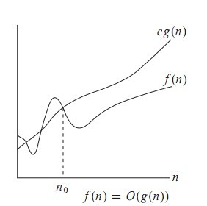
Big Oh (O)
f(n)= O(g(n)) iff there exist positive constants c and n0 such that f(n) ≤ cg(n) for all n ≥ n0
O-notation to give an upper bound on a function

Slide 2
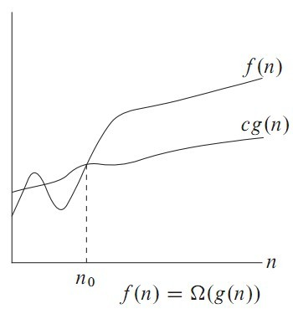
Omega Notation
Big oh provides an asymptotic upper bound on a function.
Omega provides an asymptotic lower bound on a function.

Slide 3

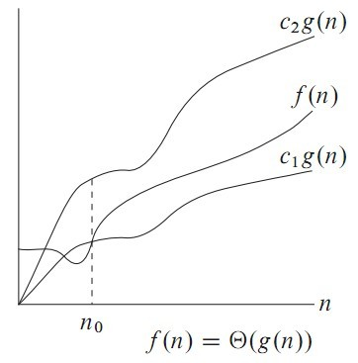
Theta Notation
Theta notation is used when function f can be bounded both from above and below by the same function g

Slide 4
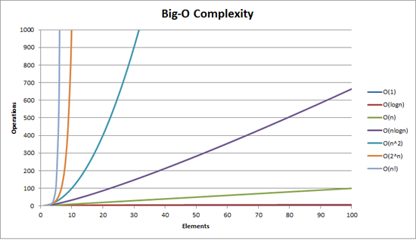
How bad is exponential complexity
Fibonacci example – the recursive fib cannot even compute fib(50)

Slide 5
The class P
The class P consists of those problems that are solvable in polynomial time on a deterministic TM.
More specifically, they are problems that can be solved in time O(n^{k}) for some constant k, where n is the size of the input to the problem
The key is that n is the size of input

Slide 6
Why obsess about primes?
Crypto uses it heavily
Primality testing actually is in P
Proven in 2002
Uses complicated number theory
AKS primality test

Slide 7
NP
NP = Non-Deterministic polynomial time
NP means verifiable in polynomial time
Verifiable?
If we are somehow given a ‘certificate’ of a solution we can verify the legitimacy in polynomial time
For example, a path p from u to v can be verified in O(n) time.

Slide 8
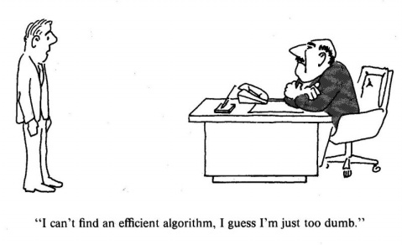
Why we need to know P-NP

Slide 9
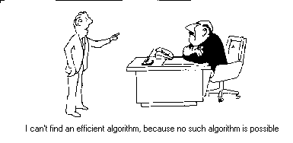
Why we need to know P-NP (2)

Slide 10
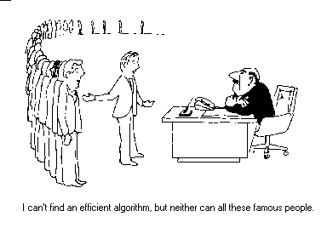
Why we need to know P-NP (3)

Slide 11
What happened to automata?
Problem is in NP iff it is decidable by some non deterministic Turing machine in polynomial time.
Remember that the model we have used so far is a deterministic Turing machine
It is provable that a Non Deterministic Turing Machine is equivalent to a Deterministic Turing Machine
Remember NFA to DFA conversion?
Given an NFA with n states how many states does the equivalent DFA have?
Worst case …. 2^{n}
The deterministic version of a poly time non deterministic Turing machine will run in exponential time (worst case)

Slide 12
NP problems
Graph theory has these fascinating pairs of problems
SAT
Hamiltonian path
In the mathematical field of graph theory, a Hamiltonian path is a path in an undirected or directed graph that visits each vertex exactly once. A Hamiltonian cycle (or Hamiltonian circuit) is a Hamiltonian path that is a cycle. Determining whether such paths and cycles exist in graphs is the Hamiltonian path problem, which is NP-complete.

Slide 13
Hamiltonian cycles
Determining whether a directed graph has a Hamiltonian cycle does not have a polynomial time algorithm (yet!)
However if someone was to give you a sequence of vertices, determining whether or not that sequence forms a Hamiltonian cycle can be done in polynomial time
Therefore Hamiltonian cycles are in NP

Slide 14
TSP
The travelling salesperson problem (TSP) asks the following question: "Given a list of cities and the distances between each pair of cities, what is the shortest possible route that visits each city exactly once and returns to the origin city?"
It is an NP-hard problem in combinatorial optimization, important in operations research and theoretical computer science.

Slide 15
SAT
A Boolean formula is satisfiable if there exists
some assignment of the values 0 and 1 to its variables that causes the formula to evaluate to 1.
CNF – Conjunctive Normal Form, ANDing of clauses of ORs

Slide 16
2-CNF SAT
Each or operation has two arguments that are either variables or negation of variables
The problem in 2 CNF SAT is to find true/false(0 or 1) assignments to the variables in order to make the entire formula true.
Any of the OR clauses can be converted to implication clauses
(¬x∨y)∧(¬y∨z)∧(x∨¬z)∧(z∨y)

Slide 17
2-SAT is in P
Create the implication graph
¬x
y
x
¬y
¬z
z

Slide 18
3 CNF SAT (3 SAT)
No known poly-time algorithm
Is it NP?
If someone gives you a solution how long does it take to verify it?
Make one pass through the formula and check
This is an NP problem

Slide 19
P is a subset of NP
Since it takes polynomial time to run the program, just run the program and get a solution
But is NP a subset of P?
No one knows if P = NP or not
Solve for a million dollars!
http://www.claymath.org/millennium-problems

Slide 20
What is not in NP?
Given a polynomial with integer coefficients, does it have integer roots
Impossible to check for all the integers
Even a non-deterministic TM has to have a finite number of states! (a good quiz/exam T/F question)
Tautology
A boolean formula that is true for all possible assignments
Here just one ‘verifier’ will not work. You have to try all possible values

Slide 21
Reducibility
a problem Q can be reduced to another problem Q’ if any instance of Q can be “easily rephrased” as an instance of Q’, the solution to Q’ provides a solution to the instance of Q
Is a linear equation reducible to a quadratic equation?
Sure! Let coefficient of the square term be 0

Slide 22
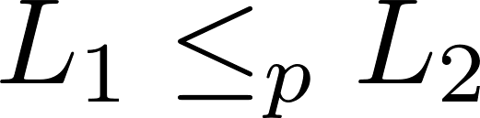
NP - hard
What are the hardest problems in NP?
That notation means that L₁ is reducible in polynomial time to L₂ .
The less than symbol basically means that the time taken to solve L₁ is no worse that a polynomial factor away from the time taken to solve L₂.

Slide 23
NP-hard
A problem (a language) is said to NP-hard if every problem in NP can be poly time reduced
to it.

Slide 24
Reducibility is a transitive relation
If we know a single problem in NP-Complete that helps when we are asked to prove some other problem is NP-Complete
Assume problem T is NP Complete
All NP problems are reducible to this problem
Now given a different problem T’
If we show T reducible to T’
Then by transitivity all NP problems are reducible to T’

Slide 25
What is in NP-Complete
For this course, we will axiomatically state that the following problems are NP-Complete
3-CNF SAT – Given any 3-CNF boolean formula, is there some assignment of values to the variables so that the formula has a true value

Slide 26
The reducibility ‘tree’
Richard Karp proved 21 problems to be NP complete in a seminal 1971 paper
karp's paper

Slide 27
Other NP complete problems
Subset sum
Given a set of positive integers and some target t > 0,
do we have a subset that sums up to that target set
Why is the naïve algorithm going to be bad?

Slide 28
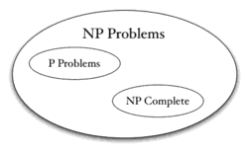
NP ≠ P (we assume)

Slide 29
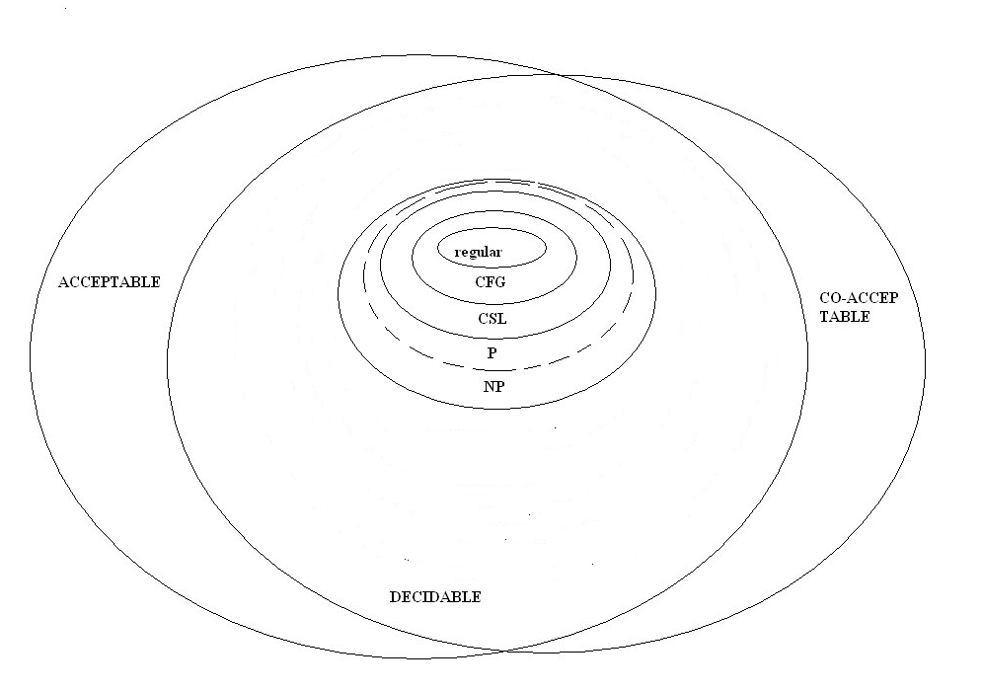
Where is what

Slide 30
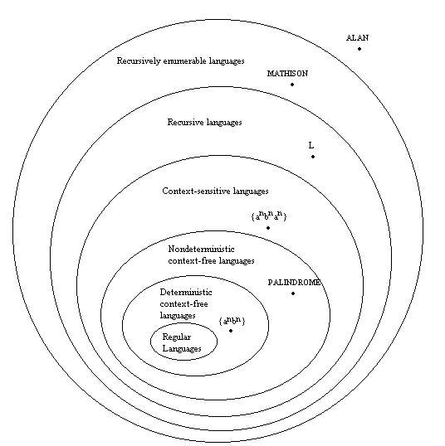
Where is what (2)

